Slide 1

How to test WebServices using SOAP UI
June 8th, ISTC workshop

Slide 2
What is a WebService?
Definition: The term Web services describes a standardized way of integrating Web-based applications using the XML, SOAP, WSDL and UDDI open standards over an Internet protocol backbone. XML is used to tag the data, SOAP is used to transfer the data, WSDL is used for describing the services available and UDDI is used for listing what services are available.
Usage:
Amazon Web Services offers a complete set of infrastructure and application services that enable you to run virtually everything in the cloud: from enterprise applications and big data projects to social games and mobile apps.
A report from 2012 done by a web analytics firm has revealed that web sites using cloud computing outfit Amazon Web Services (AWS) are visited daily by a third of all internet users worldwide.

Slide 3
Travel Holdings WebServices
Our web services are mostly oriented to the travelling industry exposing our API in order to:
Search for products (mainly hotels)
Get hotel details
Book reservations
Manage previous reservations
Internally we are also using where possible as much WS as we can in order to push our solution development to be more an more service oriented.
Commercially we are called by an average of 2 million searches per hour allowing our clients to book an average of almost 10000 reservations per day.

Slide 4
What is SoapUI?
http://www.soapui.org/
SoapUI is a free and open source cross-platform Functional Testing solution. With an easy-to-use graphical interface, and enterprise-class features, SoapUI allows you to easily and rapidly create and execute automated functional, regression, compliance, and load tests. In a single test environment, SoapUI provides complete test coverage and supports all the standard protocols and technologies. There are simply no limits to what you can do with your tests. Meet SoapUI, the world's most complete testing tool!
What can it do?
Automated testing solution including: data driven tests, load tests, scenario-based tests
MockServices feature gives the unique ability to mimic Web services and create/run Functional and Load Tests against them even before they are implemented.
Built-in reporting capabilities

Slide 5
SoapUI Test Structure
SoapUI structures functional tests into three levels; TestSuites, TestCases and TestSteps.
A TestSuite is a collection of TestCases that can be used for grouping functional tests into logical units. Any number of TestSuites can be created inside a soapUI project to support massive testing scenarios.
A TestCase is a collection of TestSteps that are assembled to test some specific aspect of your service(s). You can add any number of TestCases to a containing TestSuite and even modularize them to call each other for complex testing scenarios.
TestSteps are the "building blocks" of functional tests in soapUI. They are added to a TestCase and used control the flow of execution and validate the functionality of the service(s) to be tested.

Slide 6
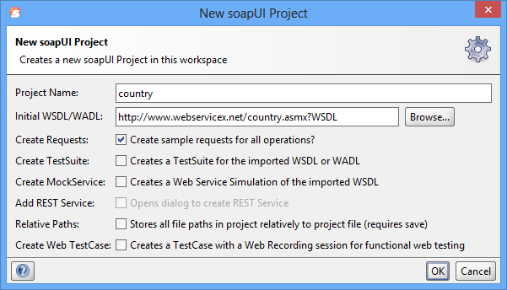
SoapUI Test Structure
A test is added by creating a new project and setting the wsdl page of your WS application. For example we used public WS which provides Country Details: http://www.webservicex.net/country.asmx?WSDL

Slide 7
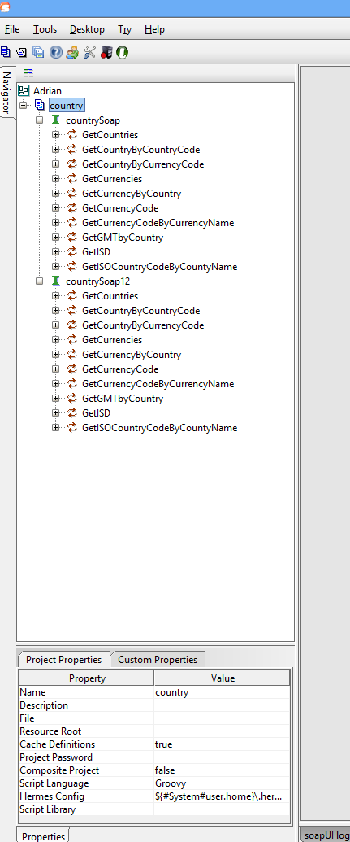
SoapUI Test Structure
When adding a new project, all of the WSs methods will be loaded with sample (empty) requests already created.
Opening such a request will show you the editor of the .xml file which is to be sent to the web server.
SoapUI gives you possibility to see the request in the editor as xml, raw data, Outline and Form, making it easier to manually edit the data you plan to send to the WS server.
The response received is also shown (on the right side of the tool’s layout) as xml, raw data, Outline or Form, making it easier to read.

Slide 8
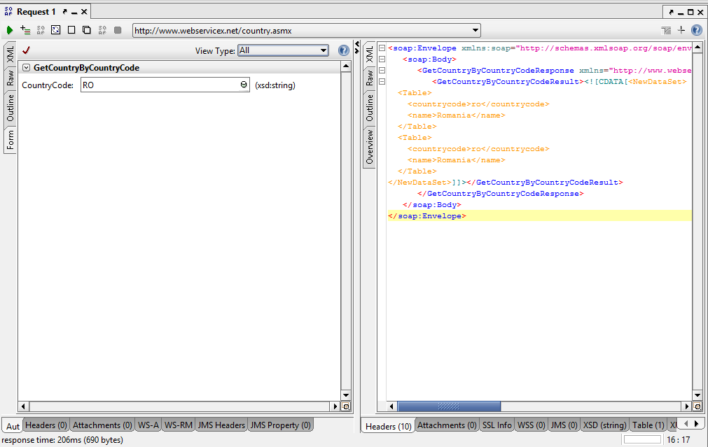
SoapUI Test Structure

Slide 9
Data Driven Tests
http://www.soapui.org/
SoapUI is a free and open source cross-platform Functional Testing solution. With an easy-to-use graphical interface, and enterprise-class features, SoapUI allows you to easily and rapidly create and execute automated functional, regression, compliance, and load tests. In a single test environment, SoapUI provides complete test coverage and supports all the standard protocols and technologies. There are simply no limits to what you can do with your tests. Meet SoapUI, the world's most complete testing tool!
What can it do?
Automated testing solution including: data driven tests, load tests, scenario-based tests
MockServices feature gives the unique ability to mimic Web services and create/run Functional and Load Tests against them even before they are implemented.
Built-in reporting capabilities

Slide 10
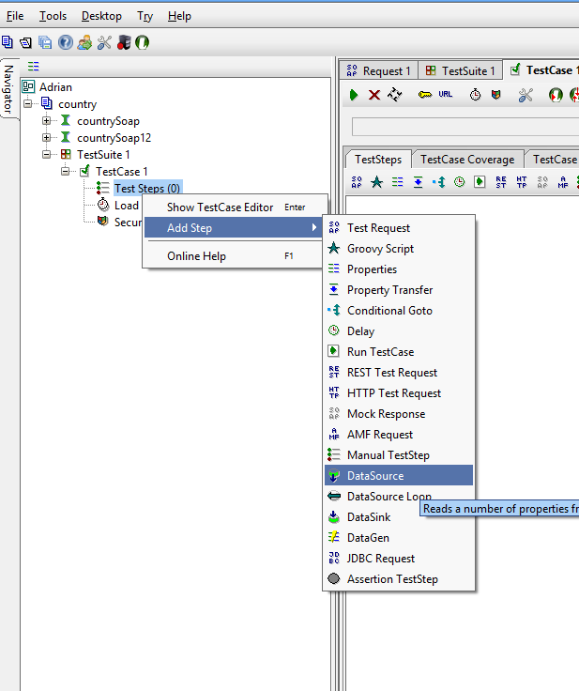
Data Driven Example
http://www.webservicex.net/uszip.asmx?WSDL
We used a public WS which we found on the internet. This is returning the details of specific ZIP codes from United States which is a good opportunity for us to validate if data received from our clients is valid or not.
Extracting from our DB random ZIP Codes, City Names and State Codes we can validate if City Name and State Code are matching the ZIP code by using it as a request and assert if the result is correct. All this test data we added into an Excel file which we used as DataSource for our test.

Slide 11
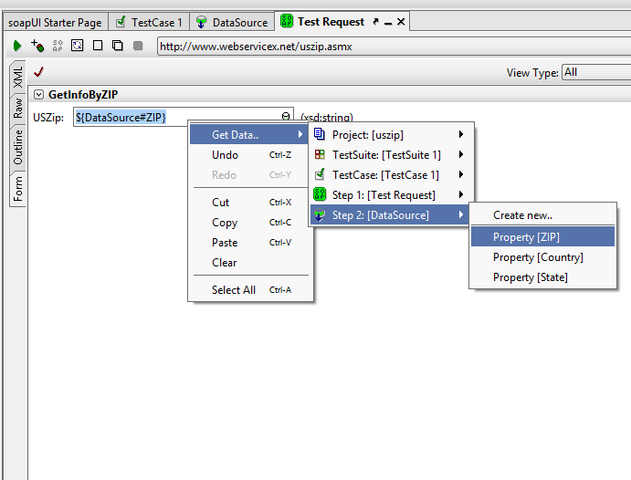
Data Driven Example
DataSource will require the file location from you and also what are the Test Properties to be used from the file.
These declared TestProperties are actually the parameters you will use for the requests or for the assertion.
When adding a new TestRequest you will have the possibility to replace the single parameter from the request with a Property from the DataSource by right-clicking the field:

Slide 12
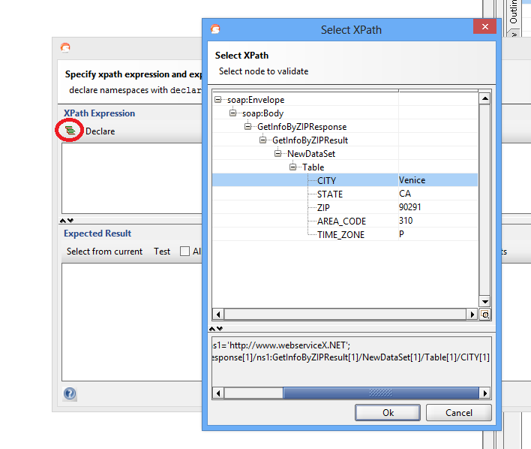
Data Driven Example
In the same TestRequest you can add an assertion and choosing Property Content / XPath Match in order to choose specific element from the response to be validated against specific TestProperty from the DataSource:

Slide 13
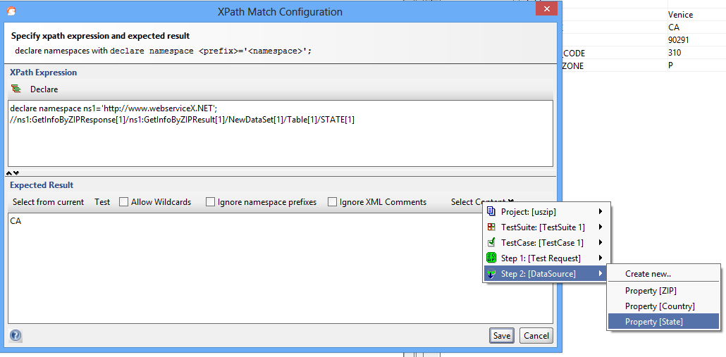
Data Driven Example
In the assertion you will need to replace the hardcoded value with the TestProperty from the DataSource:

Slide 14
Data Driven Example
Now your test will be ready and will validate request parameters with specific values from the response, all this according to the .xls DataSource.
Thank You!

